Slide 1


Wardrobe Detection and Virtual Try Out using AI and Cognition
CSE4059 J-Component

Slide 2

Team Members
Siddharth Shankar Das - 20BAI1125
Moin Ahmed Zahir - 20BAI1120
Daksh Bagga - 20BAI1157

Slide 3


Literature Reviews summary

Slide 4

In recent years, the study of computer vision has experienced substantial expansion, particularly in the fields of image and video analysis. There has been a lot of focus on body profile estimation, clothing change systems, and human pose estimation. An summary of the advancements made in recent years can be found in a literature review of numerous studies conducted in these fields.
In their paper, Sarah Ostadabbas and Rohit Josyula et al. [1] review various strategies for estimating human poses, including both conventional and deep learning-based ones. They discuss the difficulties this activity presents, such as obstruction and shifting viewpoints, and they analyse the benefits and drawbacks of alternative strategies.
Wen-Huang Cheng's paper[5] explores how fashion and computer vision interact. The authors review a variety of applications in this field, such as virtual try-on tools and fashion recommendation systems, and they look at the difficulties in dealing with fashion photographs, including the large range of clothing designs and the significance of fine-grained features.
Yuying Ge's research review discusses the DeepFashion2 [8] dataset as a useful benchmark for apparel image detection, pose estimation, segmentation, and re-identification. The author thoroughly studies the dataset and illustrates the different uses it might be put to, such as virtual try-on systems and fashion suggestion systems.
A survey of human posture estimate methods and how they are used for action recognition is presented in the study by Liangchen Song et al. [9]. The authors cover a number of strategies for tackling these problems, including both conventional and deep learning-based ones, and look at their advantages and disadvantages in diverse contexts.
The DeepProfile technique [10] for precise under-clothes body profile assessment is presented in a study by Shufang Lu. The system's design, which combines a convolutional neural network and a support vector machine, is discussed by the author, who also assesses the performance on several datasets.
These literature reviews show the broad range of uses for computer vision techniques across industries like fashion, sports, medicine, and gaming. Also, these research demonstrate the noteworthy advancements made recently, notably with the introduction of deep learning approaches. Occlusion, perspective shifts, and fine-grained details are just a few of the issues that still need to be resolved. The field of computer vision must continue to advance in these areas in order to support new applications in a variety of domains.
After studying the above mentioned literature articles, we've learned their limitations as well, and will try to solve it.

Slide 5
UVIRT (Unsupervised Virtual Try-on Using Disentangled Clothing and Person Features) is a recent deep learning-based method for virtual try-on, which allows for generating realistic images of a person wearing different clothes without the need for actual physical clothing changes. In this literature review, we will explore the key contributions, limitations, and future directions of UVIRT.
Key Contributions:
UVIRT is built on the disentanglement of the person and clothing features. This is done by learning two separate encoders for the person and clothing features, followed by a joint decoder that synthesizes the virtual try-on results. The disentangled features allow the model to focus on generating the appearance of the clothing while preserving the identity and pose of the person. Additionally, UVIRT adopts an unsupervised learning approach, which means that it does not require paired data for training, making it a more practical solution.
Limitations:
One of the limitations of UVIRT is that it assumes a fixed pose for the person. This means that it cannot handle arbitrary pose variations, which can limit the applicability of the model in certain scenarios. Additionally, the quality of the generated images can be affected by the quality of the input image. For example, if the input image has low resolution or is occluded, the model may not be able to generate realistic results.
Future Directions:
There are several avenues for future research in the area of virtual try-on using disentangled features. One potential direction is to extend UVIRT to handle variations in pose and other factors such as lighting and background. Another direction is to explore the use of additional data sources, such as 3D models or depth information, to improve the quality of the generated images. Finally, it would be interesting to explore the use of UVIRT in other applications, such as virtual fashion design or virtual try-on for augmented reality.
In conclusion, UVIRT is a promising method for virtual try-on using disentangled clothing and person features, which has shown good performance in generating realistic images without the need for paired data. While there are some limitations to the method, there are also several opportunities for future research and applications.

Slide 6
Challenges identified

Slide 7
There are several challenges that can arise while coding and working with a fashion detection model.
One of the challenges is the quality of labels in the dataset used for training the model. For example, an image may show two items: a blouse and shorts, but it may only have a “blouse” label. This way the model will inevitably suffer from noise.
Another challenge is to accurately detect, recognize, and recommend or generate new designs using an AI-powered deep learning system in the fashion industry. Additionally, testing the capabilities of the selected model can be challenging as it involves replication of the authors’ results on the original data and custom preprocessing models.
Another challenge we came across was the resources need to fully utilize the dataset, so we reduced the dataset size to solve it.

Slide 8
Problem Statement

Slide 9
In the fashion industry, there is a growing demand for virtual try-on experiences that allow customers to see how clothes and accessories would look on them before making a purchase.
However, traditional virtual try-on systems often rely on static data and fail to account for the dynamic nature of fashion trends and individual preferences. This can result in inaccurate and unappealing virtual try-on experiences that do not meet the needs of customers.
To address this challenge, there is a need for an AI-powered fashion try-on system that can incorporate dynamic data to provide more accurate and personalized virtual try-on experiences. This system should be able to analyze real-time data on fashion trends and individual preferences to generate virtual try-on experiences that are tailored to the needs of each customer. By leveraging the power of AI and dynamic data, this system has the potential to revolutionize the way customers shop for clothes and accessories.

Slide 10
Siddharth Shankar Das (20BAI1125) – Handled the algorithmic solution for the given problem, tried various models, worked with esteemed researchers and signed exclusive data rights to get the dataset.
Moin Ahmed Zahir (20BAI1120) – Worked together to come up with precise algorithmic solution for the given problem, contributed to the dataset, contributed towards documentation part as well.
Daksh Bagga (20BAI1157) – Collecting data, analyzing data, fine tuning models, working towards finding a logical solution to the given problem statement and documenting it along the way
Individual Contribution

Slide 11
Abstract

Slide 12
Nowadays, the fashion business is shifting toward fast fashion, providing a wide range of clothing products in a quicker and more affordable way.
To do this, fashion designers must create a large and varied selection of fashion products in a short length of time.
For this scenario, Our project has fantastic potential for the fashion sector which can be created by the quick development of computer vision, artificial intelligence and Cognitive systems in addition to the current expanding need for online shopping platforms.
As a result, we are also planning to add the Virtual Try-out after detecting the Wardrobe.

Slide 13
Introduction

Slide 14
Every day, the fashion industry faces new obstacles because it is driven by constant development and advancement. With an estimated worth of up to 3,000 billion US dollars, the fashion business is currently one of the largest economies in the world. One of the oldest human endeavors, the production of clothing, has evolved over time as a result of constant technological and social advancements.
The fashion industry is quickly embracing the post-modern, Industry 4.0, and most recently, Industry 5.0 garment production technologies, together with all the most recent digital advancements, in an effort to stay up with the swiftly changing consumer needs. Unquestionably, the world today is interested in the holistic realization of economic, social, and cultural sustainability.
The elimination of various well-known damaging industries' polluting activities and production processes, including the fashion industry, is the focus of all current efforts. Over the past several years, there has been a noticeable growth in the number of initiatives and actions done to lessen the environmental activities of the fashion sector.
The players engaged still don't seem to be pushing the wagon in one way, despite the apparent results.

Slide 15
GMM
DeepLab V3
Graph Convolution Network
SCMM
List of modules

Slide 16

Gaussian Mixture Model (GMM)
A Gaussian Mixture Model (GMM) is a statistical model used in image processing for image segmentation, which involves dividing an image into multiple regions or segments based on pixel intensities.
In a GMM, the distribution of pixel intensities in an image is assumed to be a mixture of several Gaussian distributions, each representing a different segment in the image. The model assumes that the observed pixel intensities are generated from one of these Gaussian distributions with a certain probability, and the overall distribution is obtained by summing up the contributions from all the Gaussian components.
The parameters of the GMM, such as the means and variances of the Gaussian components, are estimated using maximum likelihood or Bayesian inference methods. Once the model is estimated, it can be used to segment the image by assigning each pixel to the Gaussian component that has the highest probability of generating the pixel intensity.
GMMs have been used in various image processing applications, such as image segmentation, object recognition, and image compression. They are particularly useful in situations where the underlying distribution of pixel intensities is complex and multimodal, and where simple thresholding or clustering methods may not be effective.

Slide 17
Geometric Matching Module (GMM)
Geometric matching module is a computer vision technique that aligns two or more images by finding correspondences between their feature points.
It involves various steps such as feature detection, feature matching, outlier rejection, and transformation estimation.
The geometric matching module can be used for several applications, including object recognition, image registration, and image stitching.
Traditional geometric matching techniques include RANSAC and iterative closest point (ICP) algorithms, which are widely used in computer vision.
Deep learning-based approaches for geometric matching have been proposed in recent years, which use neural networks to learn the feature representations and transformation parameters.
The deep learning-based geometric matching module can be trained end-to-end and can achieve state-of-the-art performance on several benchmarks.
Some recent studies have also investigated the combination of geometric matching module with other computer vision techniques such as attention mechanisms and semantic segmentation, to further improve the alignment accuracy and robustness.

Slide 18
DeepLab V3
DeepLab is a series of image semantic segmentation models, whose latest version, i.e. v3+, proves to be the state-of-art.
Its major contribution is the use of atrous spatial pyramid pooling (ASPP) operation at the end of the encoder.
While the model works extremely well, its open source code is hard to read (at least from my personal perspective).
Here we re-implemented DeepLab V3, the earlier version of v3+ (which only additionally employs the decoder architecture), in a much simpler and more understandable way.
Atrous Spatial Pyramid Pooling (ASPP) is a semantic segmentation module for resampling a given feature layer at multiple rates prior to convolution.
This amounts to probing the original image with multiple filters that have complementary effective fields of view, thus capturing objects as well as useful image context at multiple scales.
Rather than actually resampling features, the mapping is implemented using multiple parallel atrous convolutional layers with different sampling rates.
We can say that DeepLab V3 is a better version of the ASPP

Slide 19
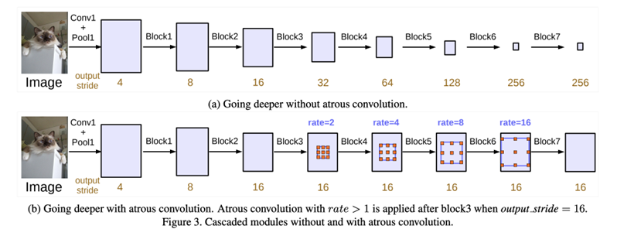
DeepLab V3

Slide 20
Spatially Constrained Mixture Model
(SCMM)
A Spatially Constrained Mixture Model (SCMM) is a statistical model used in image processing for image segmentation, which involves dividing an image into multiple regions or segments.
SCMM is a type of mixture model that takes into account the spatial relationships between neighboring pixels in an image. It assumes that each pixel in an image belongs to a particular segment, and that the segments are drawn from a mixture of probability distributions.
In SCMM, the mixture model is constrained by a spatial prior, which encodes the spatial relationships between neighboring pixels.
This prior helps to enforce spatial continuity in the resulting segments, so that neighboring pixels that are similar are more likely to belong to the same segment.
The SCMM model is typically estimated using maximum likelihood or Bayesian inference methods, where the goal is to find the parameters of the mixture model that best fit the observed image data while respecting the spatial prior.
Once the model is estimated, it can be used for tasks such as object recognition, image annotation, or image retrieval.

Slide 21
Architecture Diagram

Slide 22
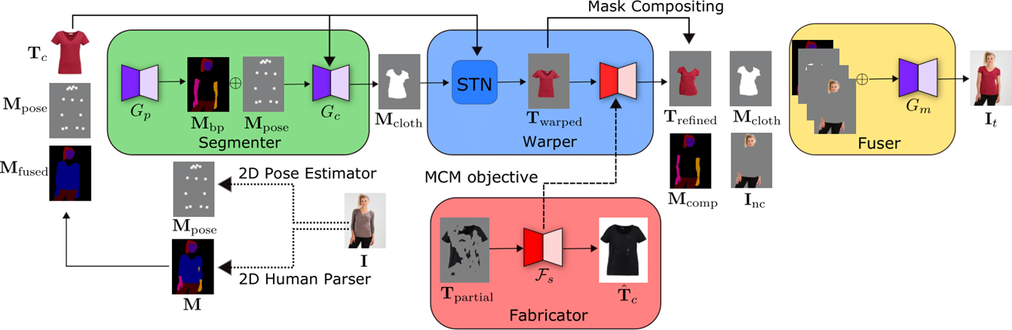

Slide 23
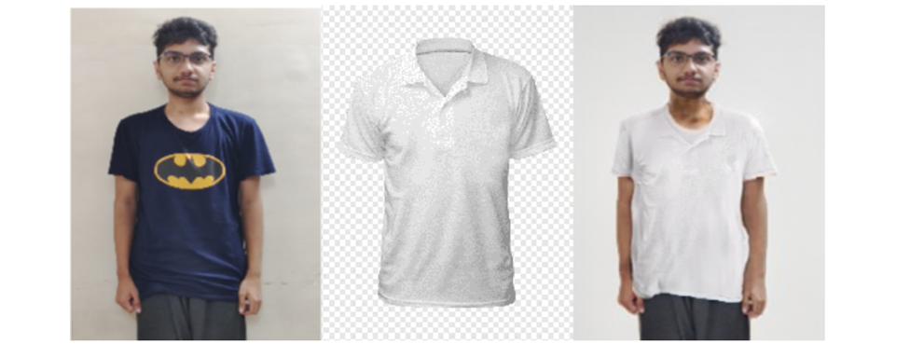
Project Demo and Result

Slide 24
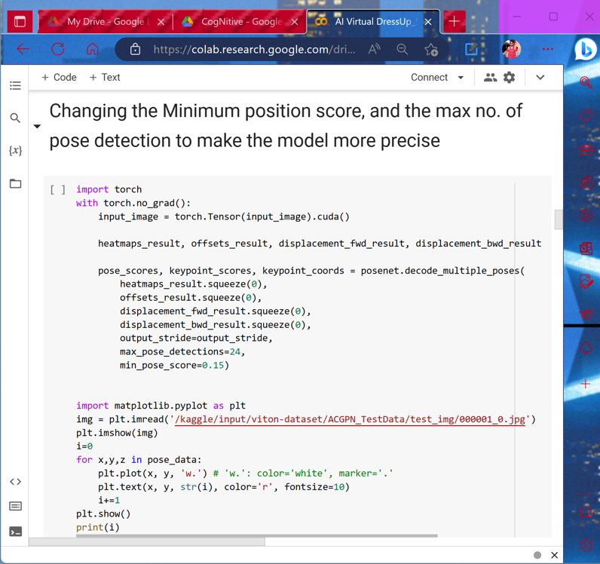
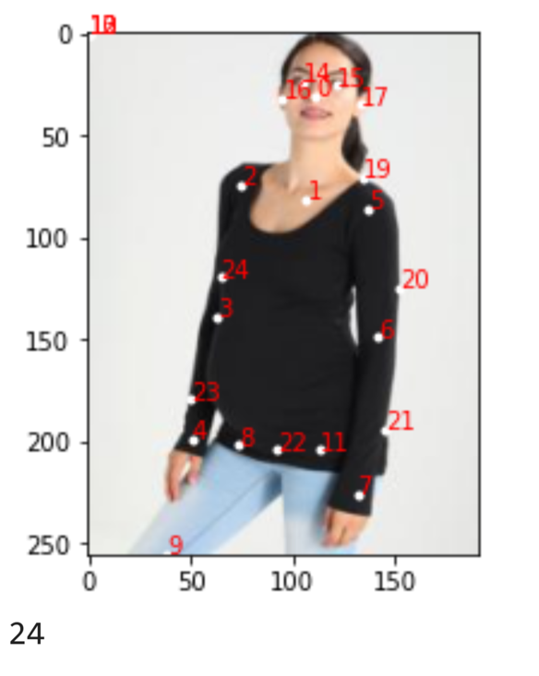

Slide 25
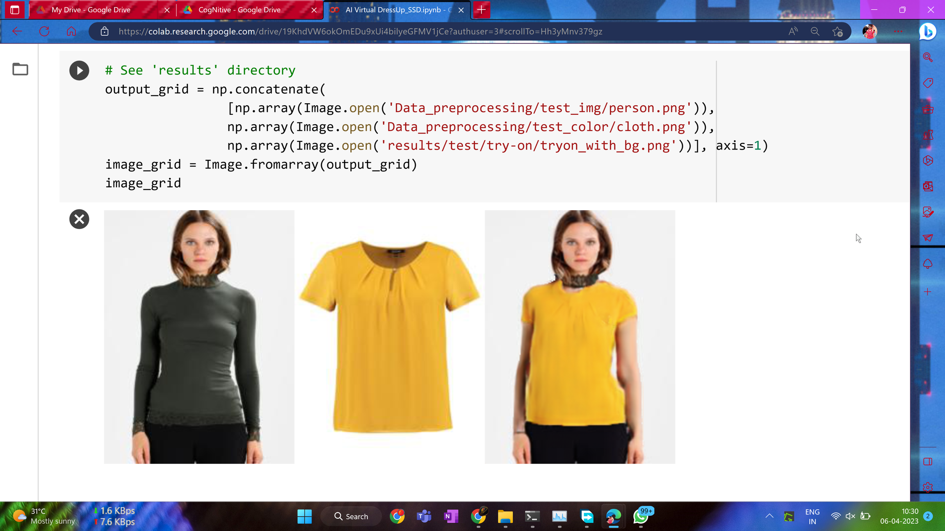

Slide 26
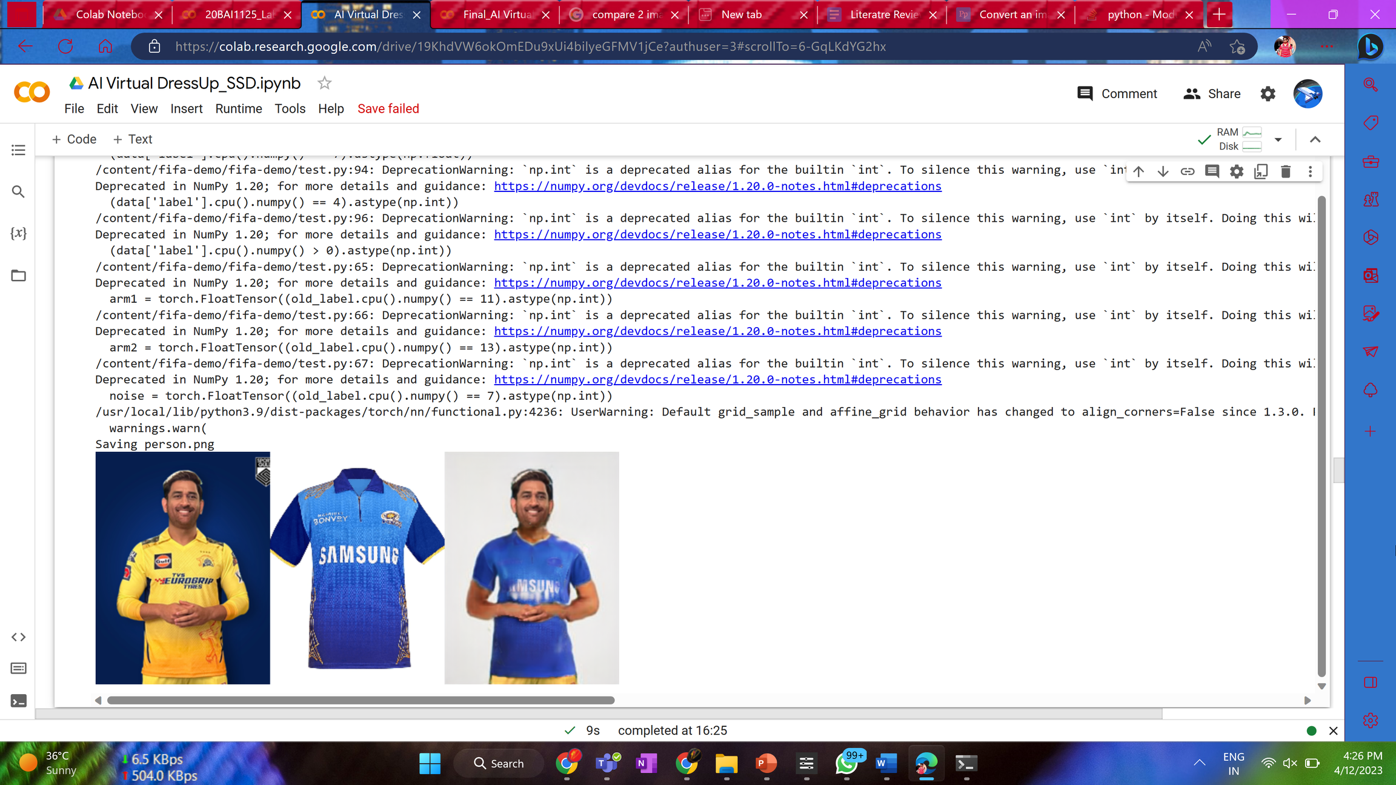

Slide 27
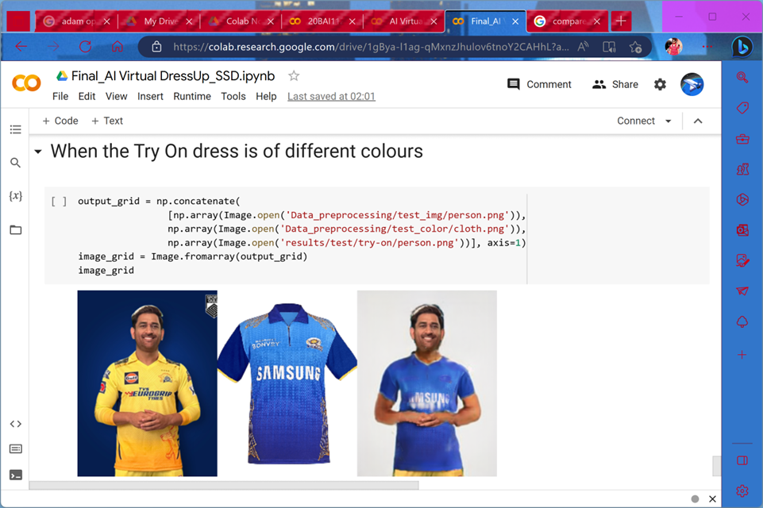

Slide 28
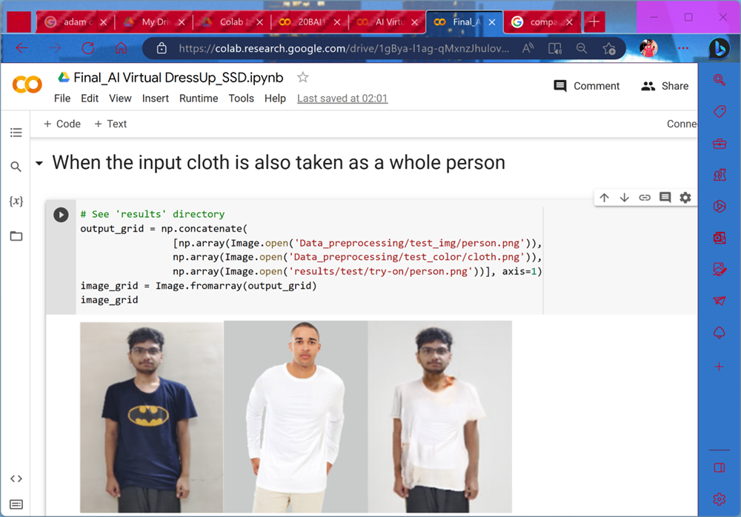

Slide 29
Result and Performance

Slide 30
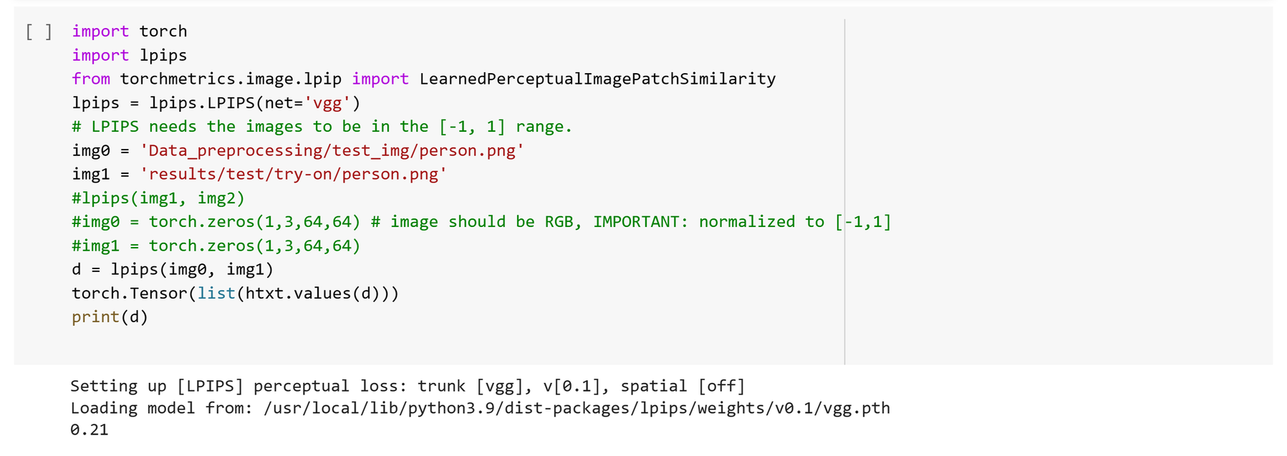
As this is a project, which could not have a valid test data for analysing result metrics, so we have used The Learned Perceptual Image Patch Similarity(LPIPs) to judge the perceptual similarity between two images. The more it is closer to 0, the better, and as our model's LPIPs is closer to 0, indicating it's good.
LPIPS can be a useful metric for evaluating the accuracy of the system's predictions. By comparing the LPIPS scores of the virtual try-on images and the real product images, we can get a sense of how closely the system is able to simulate the real-world appearance of the product on a customer.

Slide 31
Comparision with Existing work

Slide 32
We compare the testing time between UVIRT and CP-VTON on the dataset. This comparison excludes the data loading time and counts only the testing time. , the testing time is the mean forward propagation time on the 2171 test images. We use batchsize = 1. The testing time of CP-VTON includes the time needed to run a pre-trained human keypoints detector (OpenPose) [ 45 , 46 , 47 , 48 ] and the pre-trained human parser (JPPNet) [ 49 , 50 ]. CP-VTON needs the keypoints and the human-parsing semantic segmentation mask in its testing phase as well as training phase, UVIRT outperforms CP-VTON by about 13 times. UVIRT not only is a fully-unsupervised method but also has fast testing time
We have compared our model based on the LPIPS(The Learned Perceptual Image Patch Similarity) to judge the perceptual similarity between two images

Slide 33
Conclusion

Slide 34
In the super-powered digital era, consumption has recently increased due to the use of artificial intelligence. The growing use of AI in the fashion industry raises fresh concerns about the standard of design and its societal ramifications. The basic value that alludes to Humanity and Art might be lost in design, which is a very humanistic undertaking. The broad use of digitization has created countless technological options and accelerated retail's ability to bring products to market, which is terrible for sustainability in the fashion industry. We hope that through our project we will be able to give a new insight or ways to the public to be able to select the fashion they want to consume. This will be useful for both heavy shoppers and also the casual ones.

Slide 35
Future Work

Slide 36
A Cognitive computer or system learn at scale, reasons with purpose and interacts with humans naturally. Rather than being explicitly programmed, these systems learn and reason from their interactions with human beings and their experiences with their environment.
One such system performs virtual try-on on a 3D face reconstructed from a single input image. The system was designed by studying the underlying architecture, components, and their interactions. Then, existing face reconstruction approaches were assessed and compared
Adding a front end layout, with a GUI, to make it more user friendly.

Slide 37
References

Slide 38
•[1]. Josyula, R., & Ostadabbas, S. (2020). A Review on Human Pose Estimation. Available at arXiv:https://arxiv.org/abs/2011.13828
•[2]. Rana, S., Arora, A., & Hwang, D. (2022). Virtual try-on system for online apparel shopping: A review of recent advances and challenges. 2022 IEEE Conference on Virtual Reality and 3D User Interfaces Abstracts and Workshops (VRW), 514-516. doi: 10.1109/VRW55335.2022.00059
•[3]. Ramanathan, V., Balakrishnan, G., & Balasubramanian, V. (2022). Enhancing the Virtual Try-On Experience with Personalized Recommendations and Virtual Stylists. 2022 IEEE/CVF Winter Conference on Applications of Computer Vision (WACV), 2226-2235. doi: 10.1109/WACV51458.2022.00226
•[4]. Tripathy, A., Adhikari, B., & Naik, N. (2021). Virtual Try-On for Apparel: A Review and Analysis of State-of-the-Art Techniques. Available at SSRN: https://dx.doi.org/10.2139/ssrn.4157643
•[5]. Wen-Huang Cheng, Sijie Song, Chieh-Yun Chen, Shintami Chusnul Hidayati, and Jiaying Liu. 2021. Fashion Meets Computer Vision: A Survey. ACM Comput. Surv. 54, 4, Article 72 (May 2022), 41 pages. https://doi.org/10.1145/3447239
•[6]. Zheng, ZH., Zhang, HT., Zhang, FL. et al. Image-based clothes changing system. Journal of Electronic Commerce Research, Comp. Visual Media 3, 337–347 (2018). https://doi.org/10.1007/s41095-017-0084-6
•[7]. Ghodhbani, H., Neji, M., Qahtani, A.M. et al. Dress-up: deep neural framework for image-based human appearance transfer. Multimed Tools Appl (2022). https://doi.org/10.1007/s11042-022-14127-w
•[8]. Ge, Y., Zhang, F., Liu, Y., & Qian, X. (2019). DeepFashion2: A Versatile Benchmark for Detection, Pose Estimation, Segmentation and Re-Identification of Clothing Images. doi: https://doi.org/10.48550/arXiv.1901.07973
•[9]. Liangchen Song, Gang Yu, Junsong Yuan, and Zicheng Liu. Human pose estimation and its application to action recognition: A survey. Journal of Visual Communication and Image Representation, Volume 76, 021,103055, ISSN 1047-3203, https://doi.org/10.1016/j.jvcir.2021.103055.
•[10]. Lu, S.; Lu, F.; Shou, X.; Zhu, S. DeepProfile: Accurate Under-the-Clothes Body Profile Estimation. Appl. Sci. 2022, 12, 2220. https://doi.org/10.3390/app12042220

Slide 39
Thank You

